Slide 1

The Maryland SPARC Collaborative presents:
Optimizing Rapid Diagnostic Tests for the Management of Bloodstream Infections
July 10, 2019
1:30-2:30pm EST
Dial-in: (800) 672-8963

Slide 2

Optimizing Rapid Diagnostic Tests for the Management of Bloodstream Infections
Kimberly Claeys, PharmD, BCPS
Assistant Professor Infectious Diseases
University of Maryland School of Pharmacy
Antimicrobial Management Improving Clinical Outcomes Team
University of Maryland Medical Center

Slide 3
Disclosures
Speakers bureau for Luminex Corporation (maker of Verigene BC)
Received study supplies from GenMark Diagnostics and BioFire Diagnostics
This talk does not cover developing business plans and other considerations to obtain RDTs for your institution

Slide 4
Learning Objectives
To review available literature on the use of rapid diagnostic testing (RDT) inpatient to assist in the treatment of bloodstream infections (BSI)
Describe the current gap in knowledge regarding the optimal implementation of RDT within an antimicrobial stewardship (AMS) program
Discuss available literature evaluating RDT with AMS intervention in BSIs

Slide 5
Rapid Diagnostic Tests for Bloodstream Infections 101

Slide 6
RDTs for Bloodstream Infections
Traditional Workflow
Blood Cx drawn, sent to lab
Culture, organism ID and AST
Gram-stain of sample
BacT Alert detects organisms
18-24 hrs
~1 hr
24-48 hrs
RDT-integrated Workflow
Blood Cx drawn, sent to lab
Culture, organism ID and AST
Gram-stain of sample
BacT Alert detects organisms
Sample to RDT
18-24 hrs
~1 hr
0.5 - 7 hrs
24-48 hrs
Courtesy J. Kristie Johnson

Slide 7
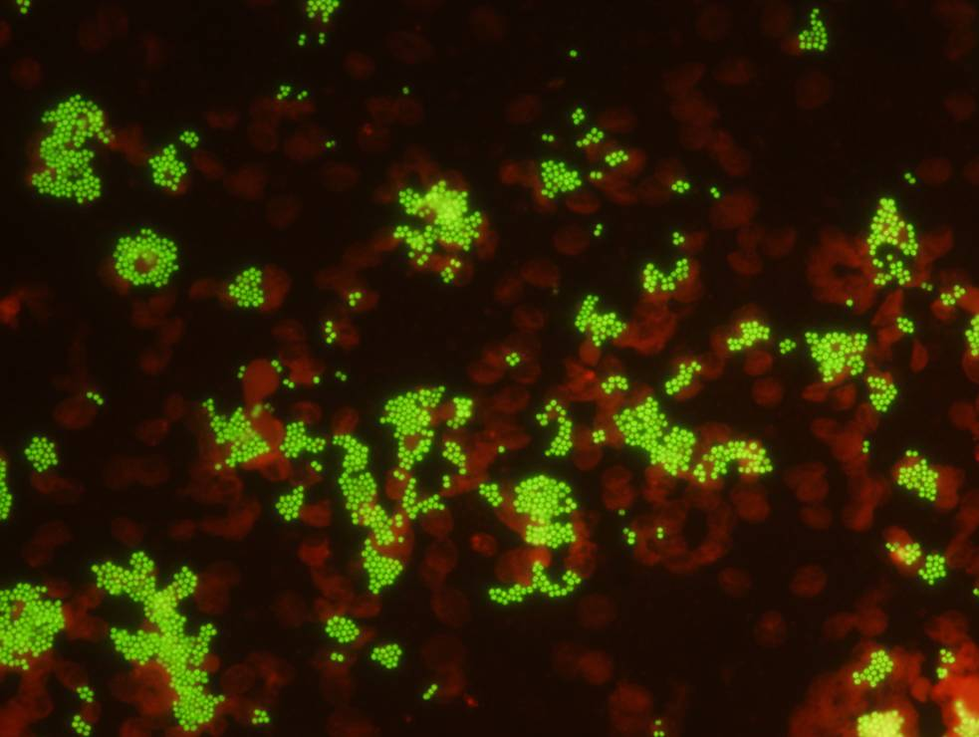
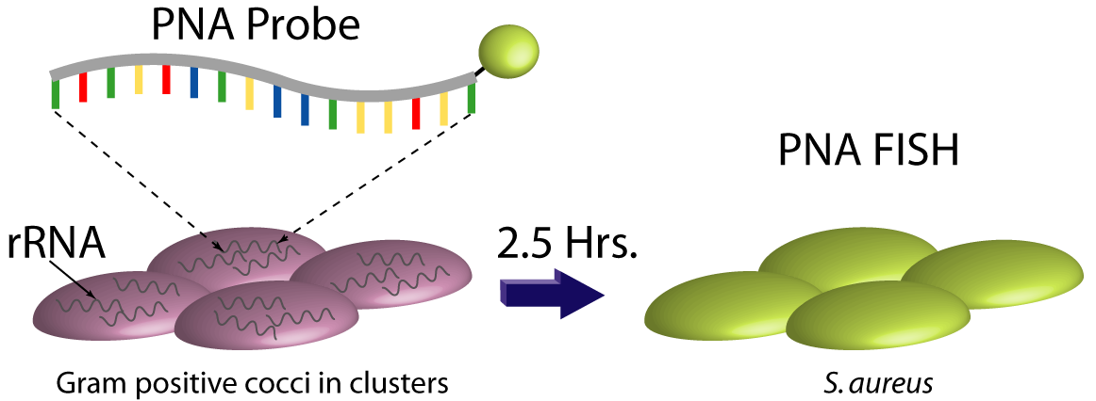
RDTs for Bloodstream Infections
Technology | Organisms | Resistance Markers | Turn-around Time
Peptide Nucleic Acid Fluorescence In Situ Hybridization (PNA FISH®) | S. aureus vs CoNS E. faecalis vs other Enterococcus spp. | mecA | 0.3-1.5 hrs
 | E. coli vs K. pneumoniae vs P. aeruginosa
 | C. albicans/parapislosis vs C. tropicalis vs C. glabrata/krusei
S. aureus
Fuchs et al. AEM 1998
Courtesy J. Kristie Johnson

Slide 8
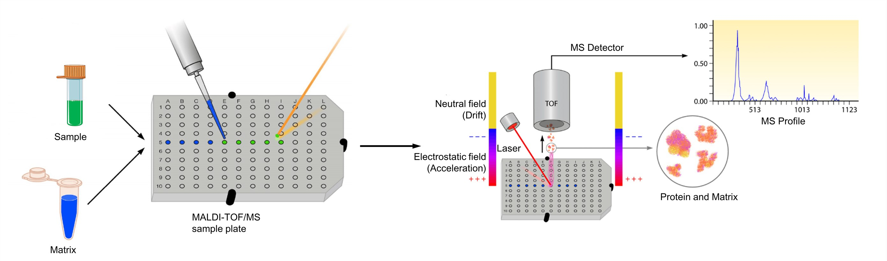
RDTs for Bloodstream Infections
Technology | Specimen Type | Organisms Detected | Resistance Markers | Turn-around Time
Matrix-assisted laser desorption ionization time-of-flight mass spectrometry (MALDI-TOF MS) | All body sites | Large database of bacteria and yeast | None (yet) | 0.2 hrs
Fournier PE et al. Nature Reviews Microbiology 2013
Courtesy J. Kristie Johnson

Slide 9
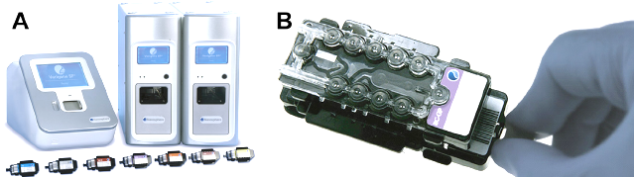
RDTs for Bloodstream Infections
Technology | Organisms | Resistance Markers | Turn-around Time
Nucleic acid microarray | Staphylococcus spp., Streptococcus spp., E. faecalis, E. faecium, Listeria spp. | mecA, vanA, vanB | 2.5
 | E. coli, K pneumoniae, K. oxytoca, P. aeruginosa, Acinetobacter spp., Proteus spp., Citrobacter spp., Enterobacter spp. | KPC, NDM, CTX-M, VIM, IMP, OXA
Bork JT, et al. Antimicrob Agents Chemother. 2014
Courtesy J. Kristie Johnson

Slide 10
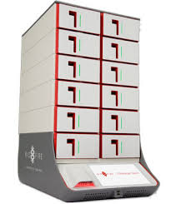
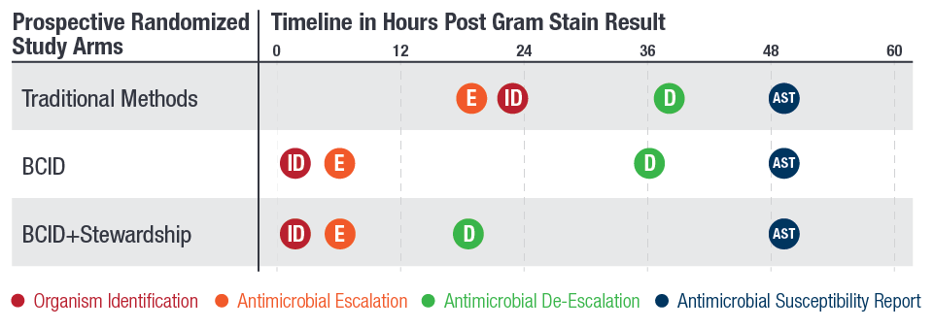

RDTs for Bloodstream Infections
Technology | Organisms | Resistance Markers | Turn-around Time
Multiplex PCR | Staphylococci; Streptococci; Enterococcus; Listeria; | mecA, vanA, vanB, KPC | 1 hr
 | A. baumannii, H. influenza, N. meningitides, P. aeruginosa, Enterobacter cloacae, E. coli, K. oxytoca, K. pneumoniae, Proteus spp., S. marcescens
 | C. albicans, C. glabrata, C. krusei, C. parapsilosis, C. tropicalis
Avdic E. Infect Dis Clin N Am. 2014
Courtesy J. Kristie Johnson

Slide 11
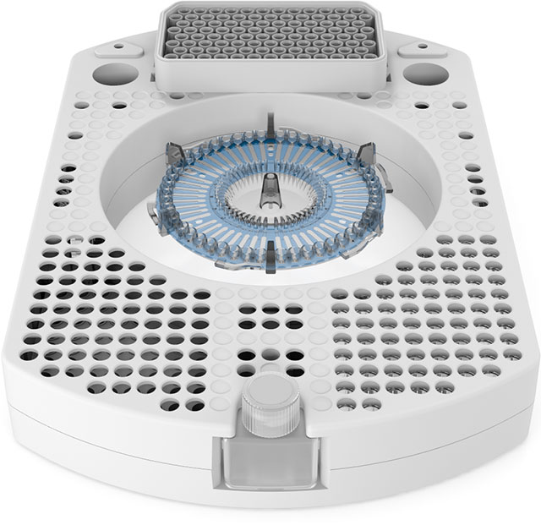
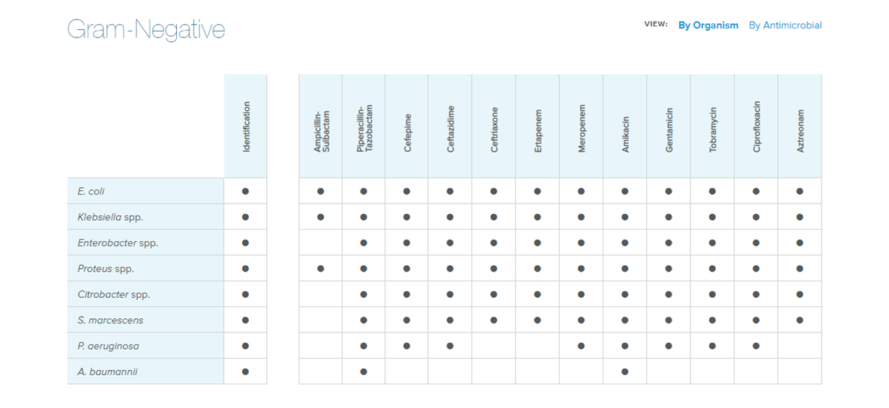
RDTs for Bloodstream Infections
Technology | Organisms | Resistance Markers | Turn-around Time
Fluorescence In Situ Hybridization and digital microscopy | S. aureus/S. lugdenensis/CoNS, Streptococcus spp., E. faecium/faecalis | None, detects phenotypic resistance (S/I/R) | 1.5 – 7 hrs
 | E. coli , K. pneumoniae, Citrobacter spp., Proteus spp., Enterobacter spp. Serratia marcescens, P. aeruginosa, A. baumannii
 | C. albicans/glabrata

Slide 12
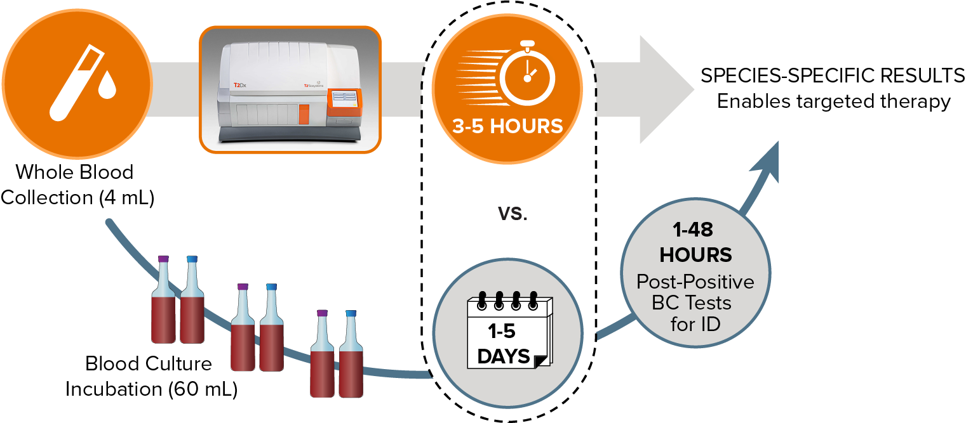
RDTs for Bloodstream Infections
Technology | Organisms | Resistance Markers | Turn-around Time
Multiplex magnetic resonance | E. faecium; S. aureus |  | 4 – 5 h (whole blood)
 | P. aeruginosa, E. coli, K. pneumoniae
 | C. albicans, C. glabrata, C. krusei, C. parapsilosis, C. tropicalis

Slide 13
Diagnostic and Antimicrobial Stewardship – Collaboration is Key

Slide 14
Molecular Rapid Diagnostic Tests
Identify organisms or resistance genes in bacteria, viruses, and/or fungi
Aid in the diagnosis of infections
Answers important clinical questions sooner than traditional microbiological techniques
Optimization requires collaboration between clinical microbiology laboratory and (AMS)
Messacar K, et al. J Clin Microbiol. 2017

Slide 15
RDTs for BSI Improve Clinical Outcomes
RDTs significantly decrease time to organisms identification
Studies have shown that RDTs, used in conjunction with antimicrobial stewardship (AMS), improve time to appropriate antibiotic therapy and mortality
 | RDT Event | RDT Total | Traditional Testing Events | Traditional Testing Total | N, % Weight | OR (95% CI)
RDT + AMS | 177 | 1745 | 331 | 2058 | 19, 76.5% | 0.64 (0.51 – 0.79)
RDT w/o AMS | 56 | 659 | 75 | 673 | 7, 23.5% | 0.72 (0.46 – 1.22)
Total | 223 | 2404 | 406 | 2731 |  | 0.66 (0.54 – 0.80)
OR (95% CI)
Mortality outcomes RDT versus traditional testing. OR = odds ratio; CI = confidence interval
0.1 1 10
Favours RDT Favours Traditional
Timbrook TT, et al. Clin Infect Dis 2017

Slide 16
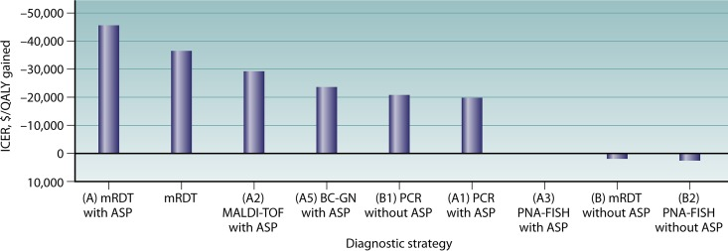
Potential Economic Benefits Too
Potential to decrease total hospital cost $2,500/BSI
RDTs with AMS associated with ~ $20 to $30k/QALY
RDTs with AMS 80% probability of cost-effectiveness
Pilakos EE, et al. Clin Microbiol Rev. 2018 Patel TS, et al. J Clin Microbiol. 2016

Slide 17
RDTs for BSI Improve Clinical Outcomes
University of Nebraska Medical Center survey to MDs
  Assess knowledge and confidence interpreting microbiology results
Varying responses with respect to adjustments in antibiotic based on microbiology reports
  82% adjusted based on traditional microbiology
  60% adjusted based on RDT (BioFire BCID)
97 respondents completed knowledge questions
  Most common errors associated with interpretation of Enterobacteriaceae and Staphylococcal spp. and antibiotic de-escalation
Donner LM, et al. J Clin Microbiol. 2017

Slide 18
https://www.nebraskamed.com/sites/default/files/documents/for-providers/asp/bcid-misinterpretation.pdf

Slide 19
RDTs for BSI without AMS
Prospective randomized trial
Adults, first episode Gram-positive BSI
    Standard microbiological techniques
    RDT with PNA-FISH (no AMS)
Primary objective = time to optimal or effective therapy
Outcome | No RDT (N = 114) | RDT (N = 106) | P-value
Effective antibiotics (n,%) | 26 (32.9) | 19 (24.8) | 0.5
Time to effective, median (IQR), h | 0 (0, 9.7) | 0 (0, 8.8) | 0.54
Cosgrove SE, et al. Diagn Microbiol Infect Dis. 2016

Slide 20
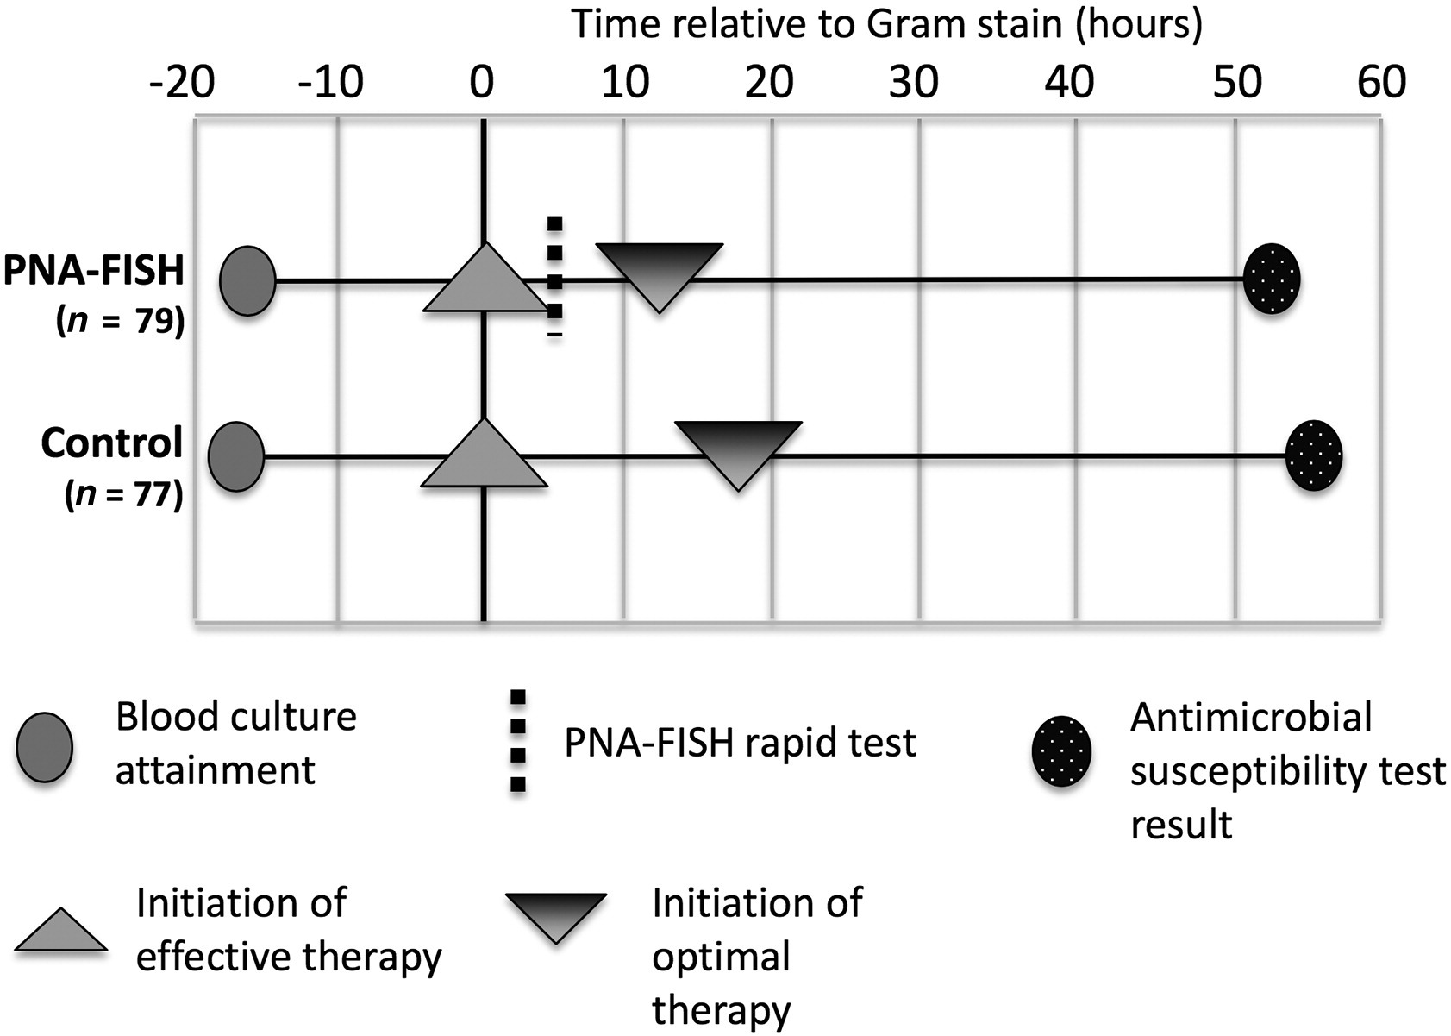
RDTs for BSI without AMS
Outcome | No RDT (N = 114) | RDT (N = 106) | P-value
Optimal antibiotics (n, %) | 19 (24) | 19 (24.7) | 0.5
Time to optimal, median (IQR), h | 18.1 (0, 50.6) | 12.1 (0, 51.8) | 0.92
Cosgrove SE, et al. Diagn Microbiol Infect Dis. 2016

Slide 21

Other Considerations for Optimizing RDT use within AMS Programs

Slide 22

Strategies to Integrate RDT Results
Clinical Decision Support
Antibiotic Treatment Algorithm
RDT-specific Antibiogram
Provider Education

Slide 23
Sustained Impact of AMS Interventions with RDTs in BSI
Quasi-experimental study in adults with GP BSI
  Phase I = RDT
  Phase II = RDT + AMS
  Phase III = RDT
Primary objective = time to optimal antibiotic therapy
Secondary objectives = clinical outcomes, LOS and mortality
Avdic E, et al. J Antimicrob Chemother. 2017

Slide 24
Baseline (7 months)
Microbiology
  Notification of results of GPC
  Report Gram-stain, ID, AST in EMR
  RDT with PNA FISH
Stewardship
  Pre-Rx review restricted agents
  Post-Rx review, select services
Intervention (7 months)
Microbiology
  Notification of results of GPC
  Report Gram-stain, ID, AST in EMR
  RDT with Verigene BC-GN 24/7
Stewardship
  Reviews
  Newsletter, guidelines, lectures
  Real-time intervention AMS
Post-Intervention (7 months)
Microbiology
  Notification of results of GPC
  Report Gram-stain, ID, AST in EMR
  RDT with Verigene BC-GN 24/7
Stewardship
  Pre-Rx review restricted agents
  Post-Rx review, select services
Avdic E, et al. J Antimicrob Chemother. 2017

Slide 25
Sustained Impact of AMS Interventions with RDTs in BSI
 | Pre-RDT (N = 127) | Post-RDT I (N = 137) | Post-RDT II (N = 136) | P-value
Time to optimal antimicrobial therapy, median (IQR), hours | 26 (2, 55) | 12 (4, 33) | 11 (4,37) | NS
Time to effective antimicrobial therapy, median (IQR), hours | 0.6 (0, 3.9) | 0.1 (0, 4) | 0.1 (0, 4.7) | NS
Length of stay (IQR), days | 11 (7, 19) | 9 (6, 16) | 11 (6, 20) | NS
In-hospital mortality (n, %) | 17 (13) | 17 (13) | 18 (13) | NS
Avdic E, et al. J Antimicrob Chemother. 2017

Slide 26
Strategies to Integrate RDT Results
Clinical Decision Support
Antibiotic Treatment Algorithm
RDT-specific Antibiogram
Provider Education

Slide 27
UMMC Verigene BC-GP Algorithm
Gram-Positive
(Gram stain)
Staphylococcus spp.
Other Staphylococcus
S. Aureus
S. Lugdenesis
CONs
Enterococci spp.
E. faecalis
E. feacium
Ampicillin or vancomycin
Vancomycin
Nafcillin, cefazolin
Vancomycin or D/C
Vancomycin
Streptococci spp.
S. Agalactiae
S. pyogenes
S. Pneumoniae
PCNG G, ceftriaxone, or ampicillin
PCN G or ceftriaxone + clindamycin
PCNG G, ceftriaxone, or ampicillin
Internal UMMC Data

Slide 28
UMMC VERIGENE® BC-GN Algorithm
E. coli,
K. pneumoniae, or
K. oxytoca
Citrobacter spp., Enterobacter spp.
Acinetobacter spp.
Pseudomonas aeruginosa
Proteus spp.
Non-ICU:
Ceftriaxone
ICU/Transplant/Onc:
Meropenem
Cefepime
Ampicillin/sulbactam + amikacin
Cefepime
Piperacillin/tazobactam
Gram-negative
(Gram stain)
UMMC ICU Antibiogram:
E. coli CRO S = 80%
Assumption of potential AmpC
SAM S ≈ IMP S
UMMC Antibiogram
FEP S > 90%
TZP S = 88%
Internal UMMC Data
Not to supersede clinical judgement; Internal data UMMC

Slide 29
UMMC Algorithm Validation
No Resistance
N = 322
E. coli = 92
Klebsiella = 49
Citrobacter = 5
Enterobacter = 32
P. aeruginosa = 40
CRO R = 5
(ICU = 3)
TZP I/R = 6
CRO: 98.6%
TZP: 91.5%
p = 0.0179
FEP I/R = 3
TZP R = 8
FEP: 91.9%
TZP: 78.4%
p = 0.1898
FEP I/R = 7
TZP I/R = 14
FEP: 82.5%
TZP: 60.0%
p = 0.0001
Internal data UMMC
UMMC VERIGENE® BC-GN Treatment Algorithm vs. work-horse empiric GN agent (piperacillin/tazobactam).

Slide 30
UMMC Algorithm Validation
144 cases assessed for appropriateness of antibiotics:
  Blinded review (two ID PharmDs) of antibiotic appropriateness
Overall improvement!
  Likely made better with clinician judgement
p = 0.014
Claeys KC, et al. Open Forum Infect Dis. 2018

Slide 31
UMMC Algorithm Validation
Presence of polymicrobial GN BSI, central line source, Acinetobacter spp., Enterobacter spp., associated with inappropriate algorithm recommendations (P < 0.05)
The AMS treatment algorithm would have resulted in:
  14.4% appropriate de-escalation
  4.8% inappropriate de-escalation
  5.3% appropriate escalation
  16.0% unnecessary escalation
Claeys KC, et al. Open Forum Infect Dis. 2018

Slide 32
Community Hospitals and RDT in BSI
AMS worked with Clinical Microbiology Laboratory to optimize workflow and reporting of RDT results
  Testing performed 24/7, on-site
  Emails sent to AMS or on-call hospitalist
  Review of local antibiogram data to develop RDT-based treatment recommendations
  Provider education: 1 hour session for all pharmacists, MD in-services and grand rounds
  Treatment recommendations available online through guidelines
Box MJ, et al. J Am Coll Clin Pharm. 2019

Slide 33
Community Hospitals and RDT in BSI
Quasi-experimental study of RDT + AMS for GN BSI at five community hospitals
  In those without detection of resistance, focus on decrease anti-PSA
 | Pre-RDT (N = 512) | Post-RDT (N = 539) | P-value
Median anti-PSA DOTs/PD (IQR) | 0.4 (0, 0.7) | 0.2 (0, 0.4) | < 0.001
Median total DOTs/PD (IQR) | 1 (0.9, 1.2) | 1 (0.9, 1.2) | NS
Median length of stay, days (IQR) | 5 (4, 7) | 5 (4, 7) | NS
Inpatient mortality, n (%) | 36 (7) | 28 (5.2) | NS
Antibiotic costs, $ (IQR) | 25 (14, 111) | 21 (14, 74) | 0.04
ICU patients | Pre-RDT (N = 131) | Post-RDT (N = 106) | P-value
Median anti-PSA DOTs/PD (IQR) | 0.6 (0.3, 0.9) | 0.3 (0.1, 0.7) | 0.002
Box MJ, et al. J Am Coll Clin Pharm. 2019

Slide 34
Strategies to Integrate RDT Results
Clinical Decision Support
Antibiotic Treatment Algorithm
RDT-specific Antibiogram
Provider Education

Slide 35
RDT-Specific Antibiogram Validation
Antimicrob Agents Chemother. 2018 Apr 26;62(5).
An Antibiotic Stewardship Program Blueprint for Optimizing Verigene BC-GN within an Institution: a Tale of Two Cities
Retrospective review of all blood cultures positive for GN BSI
Determine sensitivity, specificity, positive, and negative predictive value of presence/absence of beta-lactamase genes and antimicrobial susceptibility to target antimicrobials
Compare results of GN RDT with conventional microbiological testing
Pogue JM, et al. Antimicrob Agents Chemother. 2018

Slide 36
Antimicrob Agents Chemother. 2018 Apr 26;62(5).
An Antibiotic Stewardship Program Blueprint for Optimizing Verigene BC-GN within an Institution: a Tale of Two Cities
UNIVERSITY OF MARYLAND MEDICAL CENTER
Organism | Resistance marker | N | SAM | TZP | CZO | CRO | FEP | ETP | MEM | GEN | LVX | ATM
E. coli | CTX-M | 14* | 21 | 93 | 0 | 0 | 0 | 99 | 100 | 29 | 21 | 0
 | none | 91 | 44 | 88 | 82 | 98 | 98 | 100 | 100 | 83 | 70 | 100
K. pneumoniae | CTX-M | 7* | 0 | 43 | 0 | 0 | 14 | 100 | 100 | 57 | 43 | 0
 | KPC | 5* | 0 | 0 | 0 | 0 | 20 | 0 | 0 | 60 | 80 | 0
 | None | 45 | 80 | 93 | 85 | 91 | 100 | 100 | 100 | 98 | 100 | 95
K. oxytoca | none | 9* | 67 | 100 | 89 | 100 | 100 | 100 | 100 | 100 | 100 | 100
SAM: ampicillin/sulbactam; TZP: piperacillin/tazobactam; CZO: cefazolin; CRO: ceftriaxone; FEP: cefepime; ETP: ertapenem; MEM: meropenem; GEN: gentamicin; TOB tobramycin; CIP: ciprofloxacin; LVX: levofloxacin; ATM: aztreonam
Numbers for individual antibiotics are presented as percentages susceptible
Pogue JM, et al. Antimicrob Agents Chemother. 2018

Slide 37
Antimicrob Agents Chemother. 2018 Apr 26;62(5).
An Antibiotic Stewardship Program Blueprint for Optimizing Verigene BC-GN within an Institution: a Tale of Two Cities
Organism | N | Target drug | Resistance marker | N (%) resistant | Number identified by VERIGENE | SN (%) | SP (%) | PPV (%) | NPV (%)
E. coli | 106 | Ceftriaxone | Any (CTX-M)* | 15 (14) | 14 | 93 | 100 | 100 | 99
K. pneumoniae | 57 | Ceftriaxone | Any | 15 (26) | 12 | 80 | 100 | 100 | 93
K. pneumoniae | 57 | Ertapenem | KPC | 5 (9) | 5 | 100 | 100 | 100 | 100
K. oxytoca | 9 | Ceftriaxone | Any | 0 | 0 |  |  |  | 100
NPV = negative predictive value; PPV = positive predictive value; SN = sensitivity; SP = specificity
* While presence of any resistance marker was tested as a marker of ceftriaxone resistance, only CTX-M was identified in this study for E. coli
Pogue JM, et al. Antimicrob Agents Chemother. 2018

Slide 38
Pharmacists and RDTs, There’s Still Gaps
Cross-sectional survey of pharmacists involved in AMS
Total of 224 respondents
  45% ID training, 36% AMS certificate programs
  RDT utilization varied considerably (multiplex PCR most common)
  Pharmacists most common with PCR, least with multiplex PCR
  Formal AMS utilization of RDTs → Real-time alerts 50%
  Only ~ 30% have internally assessed outcomes with RDT
Foster RA, et al. Infect Control Hosp Epidemiol. 2017

Slide 39
Conclusions
Opportunities to improve antibiotic use through use of RDTs
  Become familiar with RDTs available to your institution
  Collaborate with Clinical Microbiology to understand process for testing and reporting
  Determine optimal integration of RDT into current AMS activities
    Real-time alerts, provider education, treatment algorithms
    Work-load, sustainability, etc.
  Evaluate outcomes of RDT activities at your institution
    Antibiotic optimization, post-BSI length of stay, mortality, costs
Wenzler et al. Implementation and optimization of molecular rapid diagnostic tests for bloodstream infection. Am J Health Syst Pharm. 2018 Aug 15;75(16):1191-1202

Slide 40
Optimizing Rapid Diagnostic Tests for the Management of Bloodstream Infections
Kimberly Claeys, PharmD, BCPS
Assistant Professor Infectious Diseases
University of Maryland School of Pharmacy
Antimicrobial Management Improving Clinical Outcomes Team
University of Maryland Medical Center

